Slide 1
05 Arrays

Slide 2
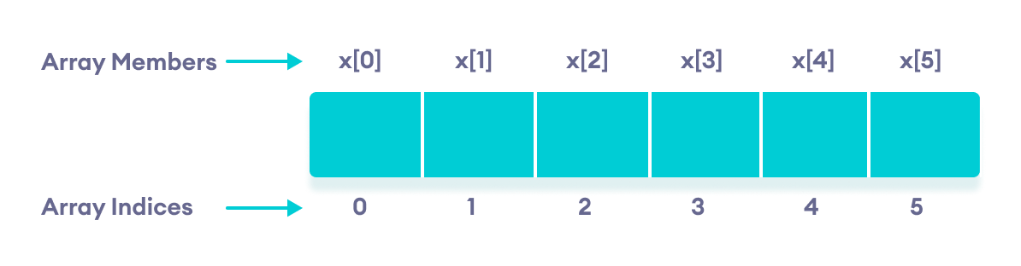

Slide 3
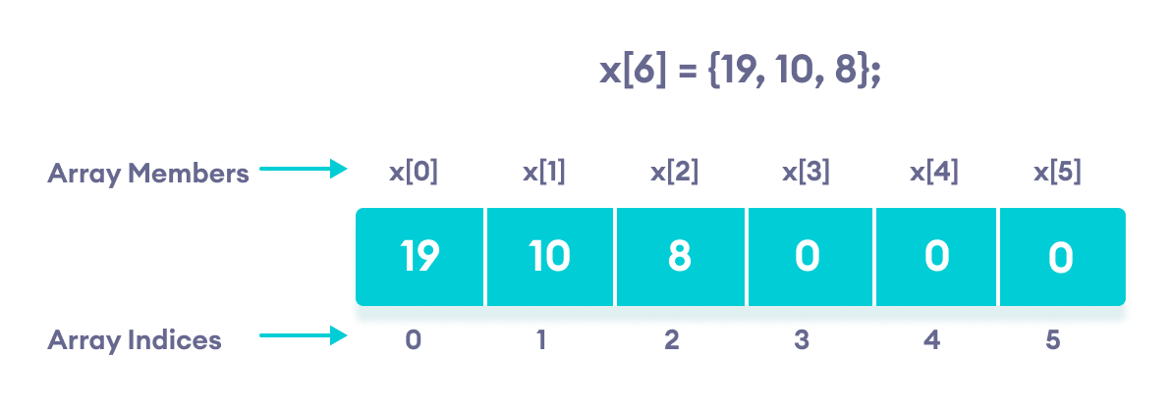

Slide 4
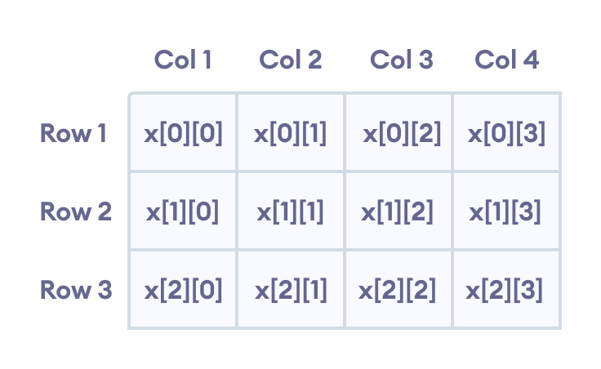
C++ Multidimensional Arrays

